Slide 1

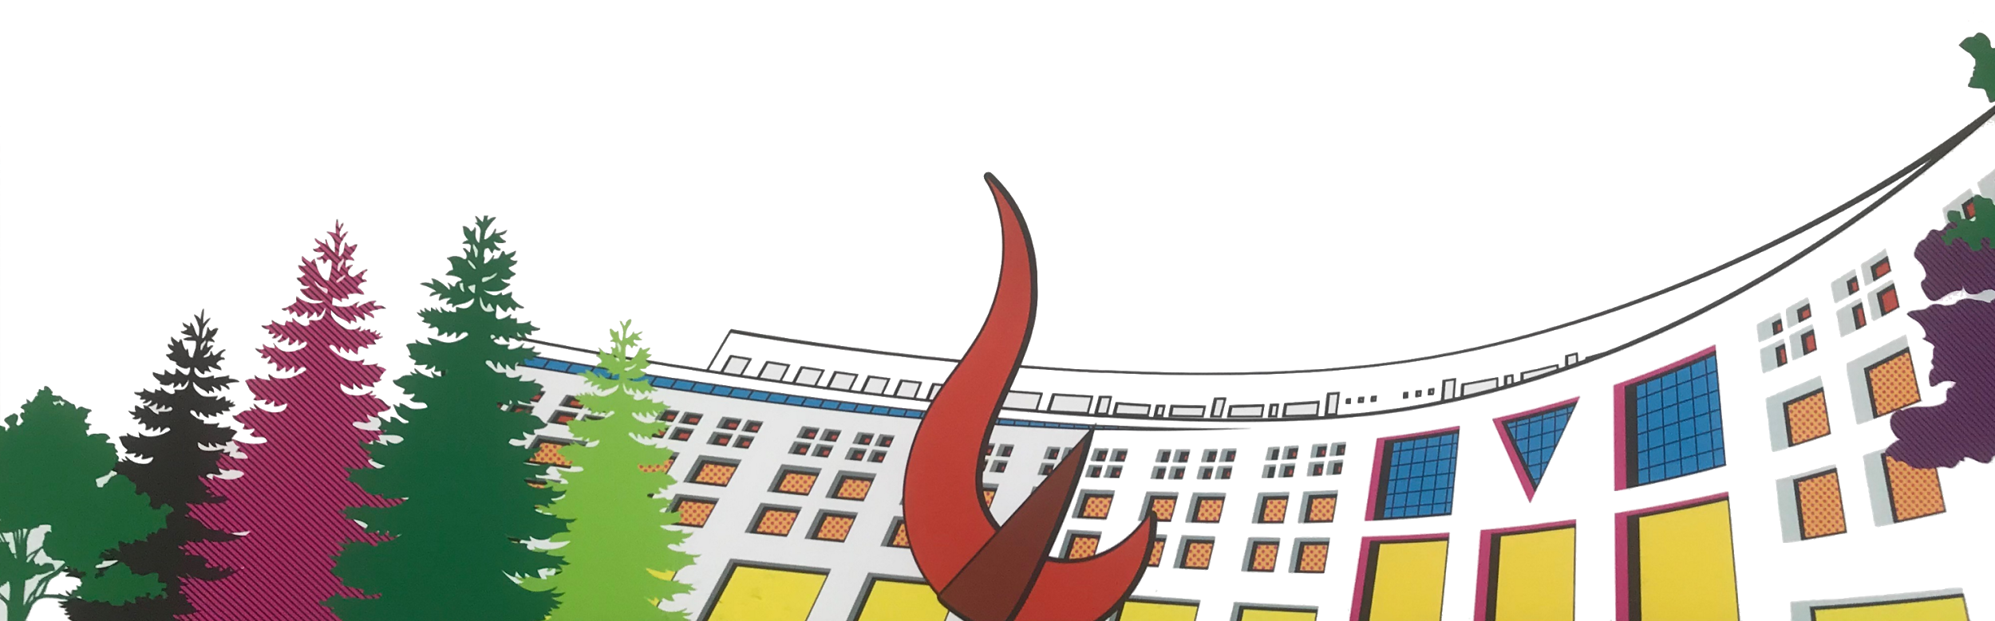

ML/DL for Everyone with
Lecture 1: Overview
Sung Kim <hunkim+ml@gmail.com> HKUST
Code: https://github.com/hunkim/PyTorchZeroToAll
Slides: http://bit.ly/PyTorchZeroAll
Videos: http://bit.ly/PyTorchVideo
Notes:
Welcome to ML/DL for Everyone with PyTorch, which covers basic deep learning concepts with Pytorch. My name is Sung Kim from HKUST.
The first lecture will overview the entire course.
All code and slides are available these locations.

Slide 2
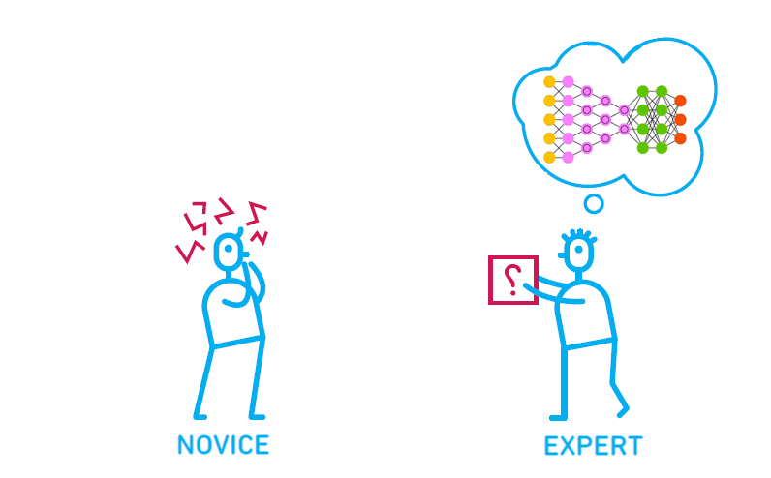
Goals
Basic understanding of machine learning/deep learning
PyTorch implementation skills
Zero to All!
Basic algebra + probability
Basic python
Adapted the Illustration by Oliver Caviglioli
Notes:
What are the goals of these lectures?
We provide the basic …
In addition, we implement these concepts using pytorch to get concrete understanding.
To take and enjoy this course, you just need
basic … basic python. Zero to All!
I guess you are standing somewhere in the between here. Hopefully this lecture can help you move towards to the exper.
Let’s get started!

Slide 3
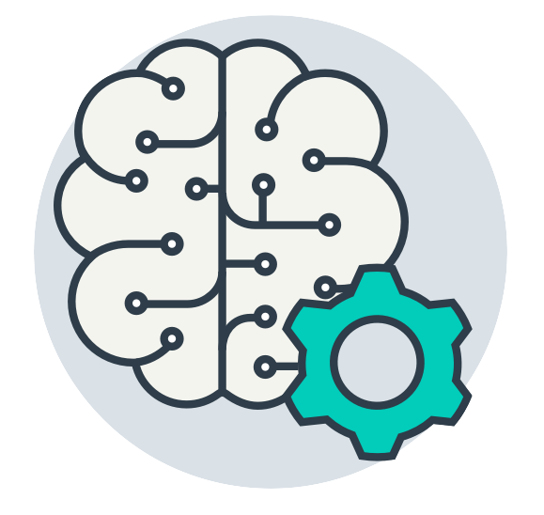
What is ML?
Notes:
What is ML?

Slide 4

What is Human Intelligence?
Notes:
How about human intelegene?

Slide 5
What is Human Intelligence?
What to eat for lunch?

Slide 6

What is Human Intelligence?
What to eat for lunch?
Information

Slide 7

What is Human Intelligence?
What to eat for lunch?
Information
Infer

Slide 8

What is Human Intelligence?
What to dress?
Information
Infer

Slide 9
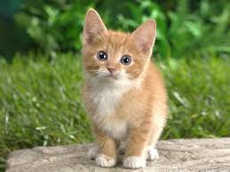
What is Human Intelligence?
What is this picture?
CAT
Image information
Prediction

Slide 10

What is Human Intelligence?
What is this number?
2
Image information
Prediction

Slide 11
What is Human Intelligence?
What would be the grade if I study 4 hours?
4 hours
? points
information
Prediction

Slide 12
Machine Learning
What to dress?
Information
Infer

Slide 13
Machine Learning
What is this picture?
CAT
Image information
Prediction

Slide 14
Machine Learning
What is this number?
2
Image information
Prediction

Slide 15
Machine Learning
What would be the grade if I study 4 hours?
4 hours
? points
information
Prediction

Slide 16
Machine Learning
Machine needs lots of training
2
Image information
Prediction

Slide 17
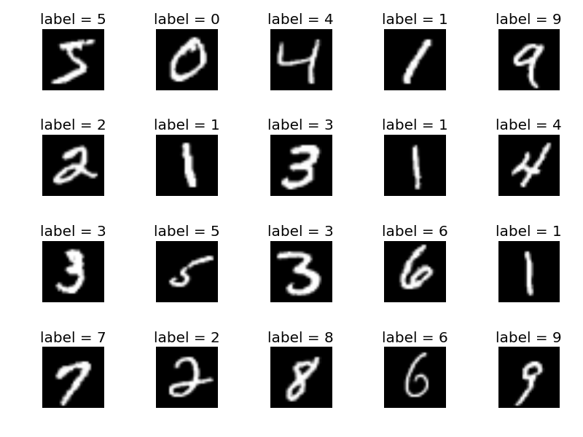
Machine Learning
Machine needs lots of training
Model
training
Labeled dataset

Slide 18
Machine Learning
Predict (test) with trained model
Trained model

Slide 19
Machine Learning
Predict (test) with trained model
Image information
Test dataset
Trained model

Slide 20
Machine Learning
Predict (test) with trained model
2
Image information
Prediction
Test dataset
Trained model

Slide 21
Machine Learning
What would be the grade if I study 4 hours?
4 hours
? points
Prediction
Hours (x) | Points (y)
1 | 2
2 | 4
3 | 6
4 | ?
Training dataset
Test dataset

Slide 22
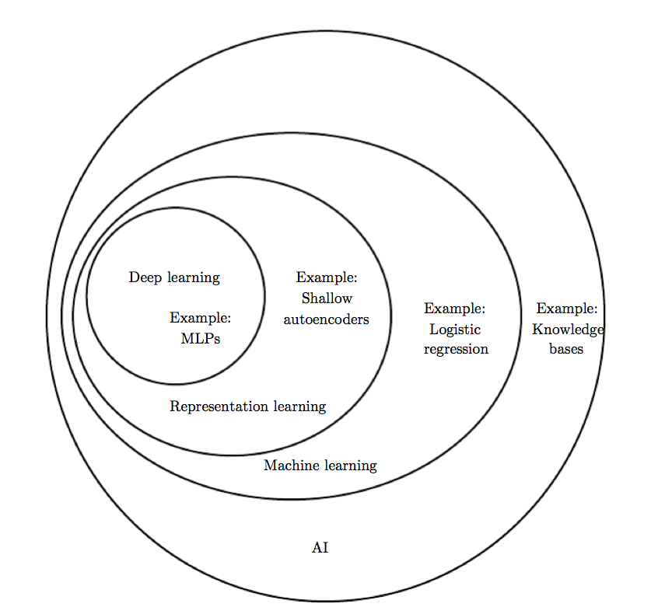
Deep Learning?
Deep Learning by Ian Goodfellow, Yoshua Bengio, Aaron Courville
Notes:
Then, what is deep learning?
More formally, we can explain this terms using this diagram from the Deep Learning book.
Any machine with intelligent, we can call AI, a very broad concept.
One solution for the AI is ML.
There are many algorithms and approaches in ML.
If you are using neural nets and the layers are deep, usually we call it deep learning.

Slide 23
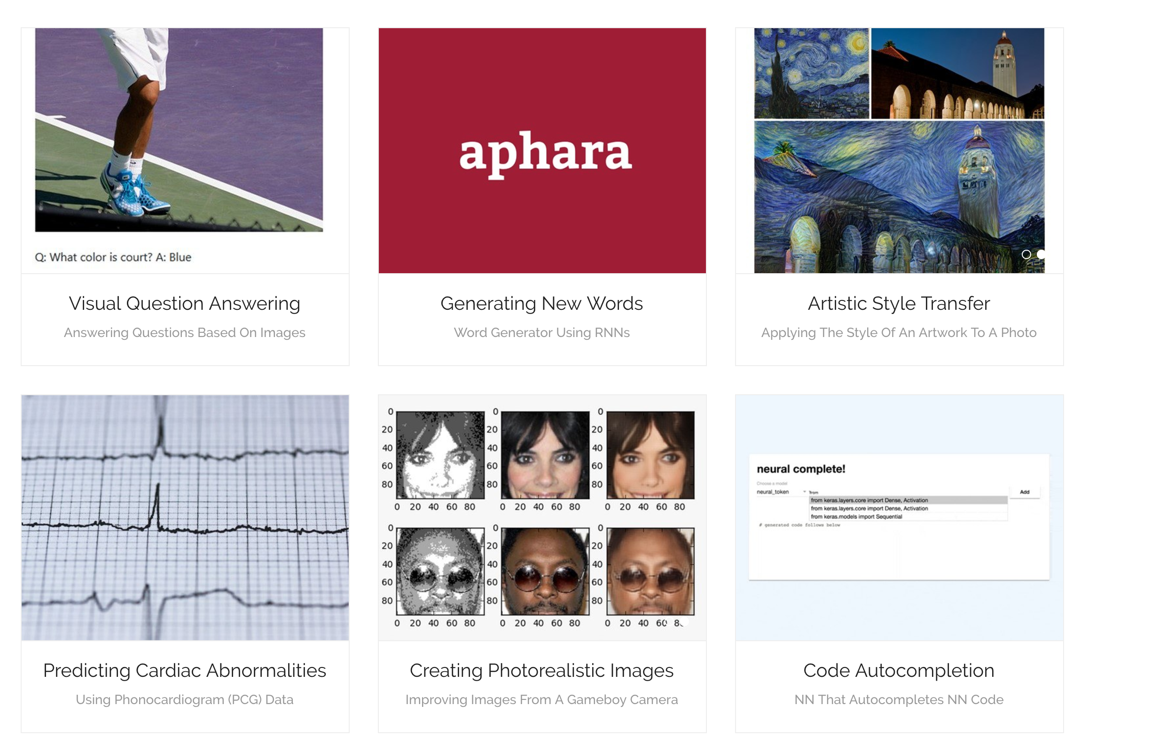
Why We Care?
More demos at https://ml-showcase.com/
Notes:
Why we care so much? Basically, deep learning works. There are many exciting demos including X, Y, and Z.

Slide 24
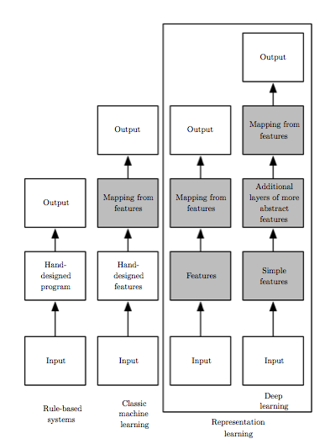
Why We Care as Developer?
Deep Learning by Ian Goodfellow, Yoshua Bengio, Aaron Courville
Notes:
Why we care as developer?
Traditional: logic comes from our mind.

Slide 25
Why We Care as Developer?
Deep Learning by Ian Goodfellow, Yoshua Bengio, Aaron Courville
Notes:
Machine learning help this process. It gets input and produce output.
However, still we need to manually select reasonable inputs for ML.

Slide 26
Why We Care as Developer?
Deep Learning by Ian Goodfellow, Yoshua Bengio, Aaron Courville
Notes:
ML changes this. Now we just need to provide all raw inputs. Then, the machine learning/deep learning learns the representations automatically.
So programming paradigm can changes.
I think all developers should know ML and DL.

Slide 27
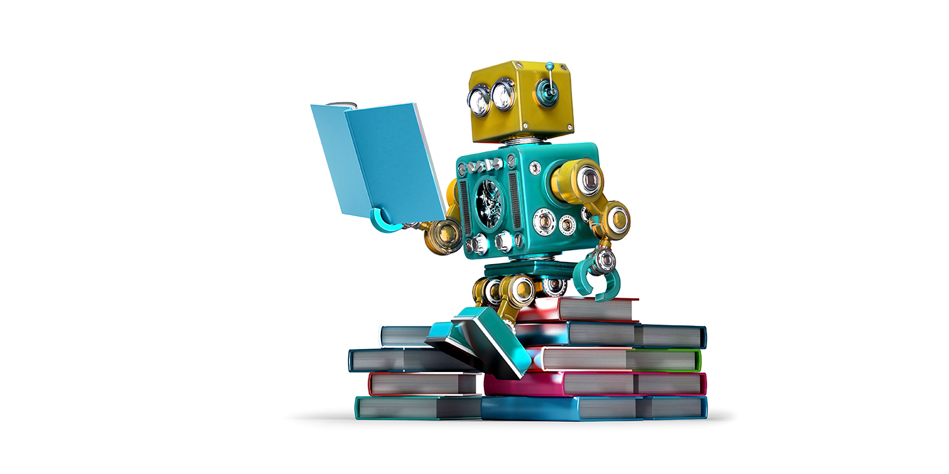
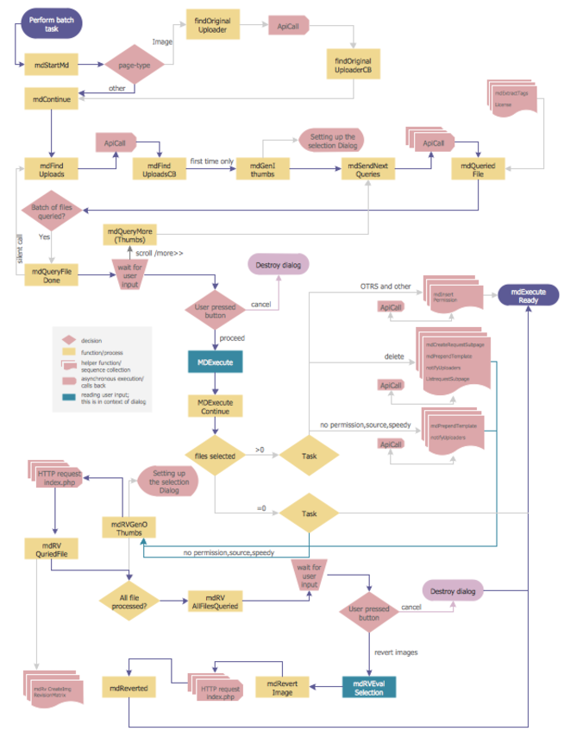

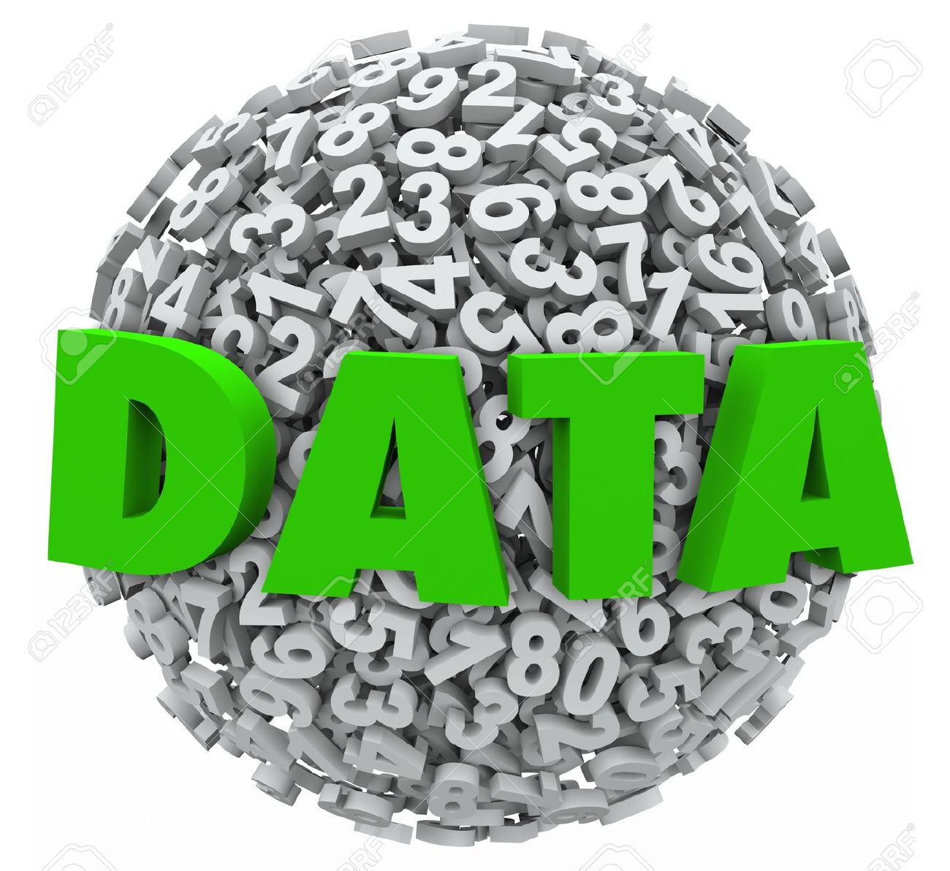
Rule based VS representation learning
Notes:
In other words. Traditionally developers program these rules.
But more and more program will use representation learning. The rules will be learned automatically.
So as a developer, it’s important to model these learning rather than program rules.
This is the goal of this lecture

Slide 28
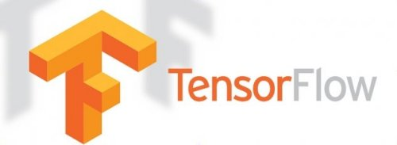

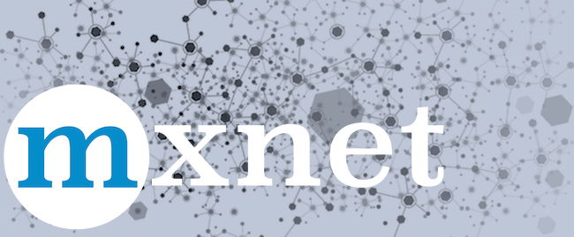
Good News
Deep Learning is not too difficult (yet)
Basic algebra + probability + python
Less than one year study
Many frameworks
Unlimited study resources
And most of all, it’s really fun
Notes:
Good news is deep learning concepts are not too hard. If you have basic math and programming, you can catch up these within one year or even within 6 months.
There are many frameworks we can use and there are many study resources including my lectures.
Most of all, it’s really fun to study.
Are you ready?

Slide 29

PyTorch is a python package that provides two high-level features:
Tensor computation (like numpy) with strong GPU acceleration
Deep Neural Networks built on a tape-based autograd system
http://pytorch.org/about/

Slide 30
Why
More Pythonic (imperative)
Flexible
Intuitive and cleaner code
Easy to debug
More Neural Networkic
Write code as the network works
forward/backward

Slide 31

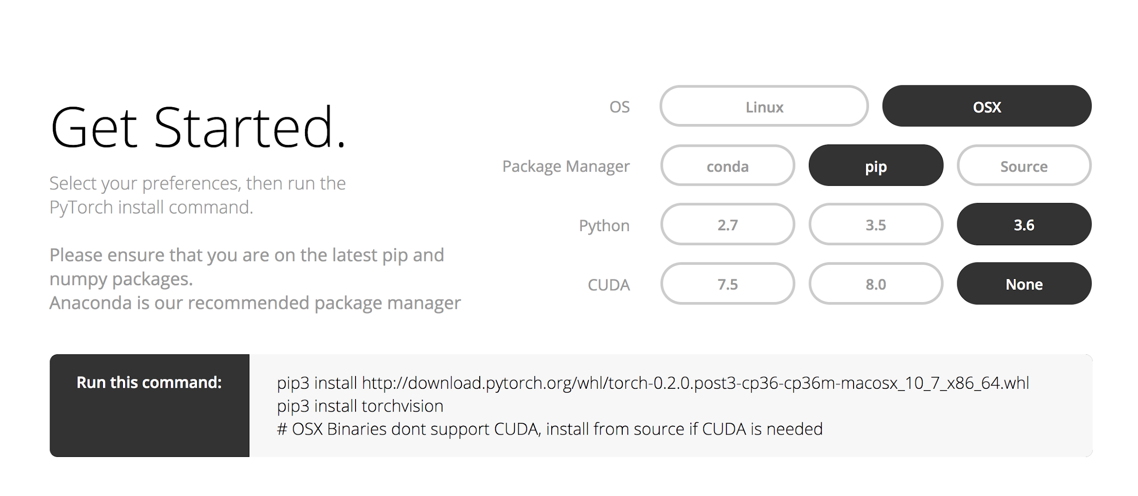
Install
http://pytorch.org

Slide 32
Exercise 1-1:
Install PyTorch on your computer!
09:40 $ python3
Python 3.6.2 (v3.6.2:5fd33b5926,Jul 16 2017, 20:11:06
[GCC 4.2.1 (Apple Inc. build 5666) (dot 3)] on darwin
Type "help", "copyright", "credits" or "license" for more information.
>>> import torch
>>> print(torch.__version__)
0.2.0_3
>>> # Happy!!

Slide 33
Topics
Linear, Logistic, softmax models
DNN: Deep Neural Net
CNN: Convolutional Neural Net
RNN: Recurrent Neural Net
Write everything in PyTorch

Slide 34


Lecture 2:
Linear Model

